Slide 1





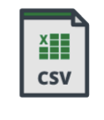

DATA FLOW
Bronze
Silver
Gold
Visualization

